Slide 1
Natural Language Processing
Unit 5 Processing Text
Faizan Javed
DataScience @ SMU

Slide 2
NLP pipelines

Slide 3
NLP pipelines

Slide 4
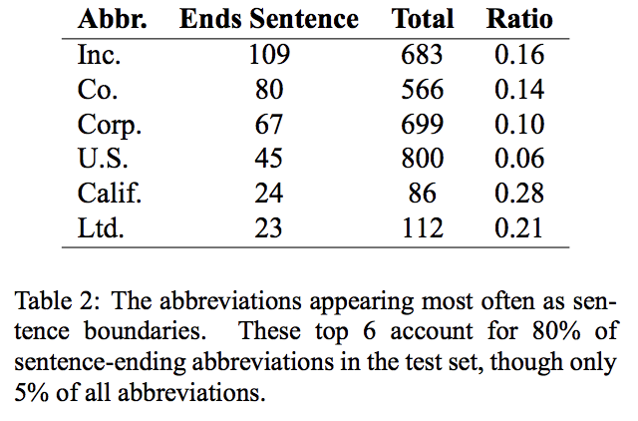
Sentence Segmentation Sentence Boundary Detection and the Problem with the U.S., acl 2009 https://www.aclweb.org/anthology/N09-2061/
Process of deciding where sentences end and begin
Period (.) is the default sentence segmentation
Simple Examples, U.S. Corporate Mr. Kolmogrov Kidding ! Christoper K. Columbus For e.g. "Are you kidding ?" asked the senator. aftermath@gmail.cs.uva.edu
“Vanilla” approach that handles majority of the cases (95%):
If it's a period, it ends a sentence.
If the preceding token is in the hand-compiled list of abbreviations, then it doesn't end a sentence.
If the next token is capitalized, then it ends a sentence.

Slide 5
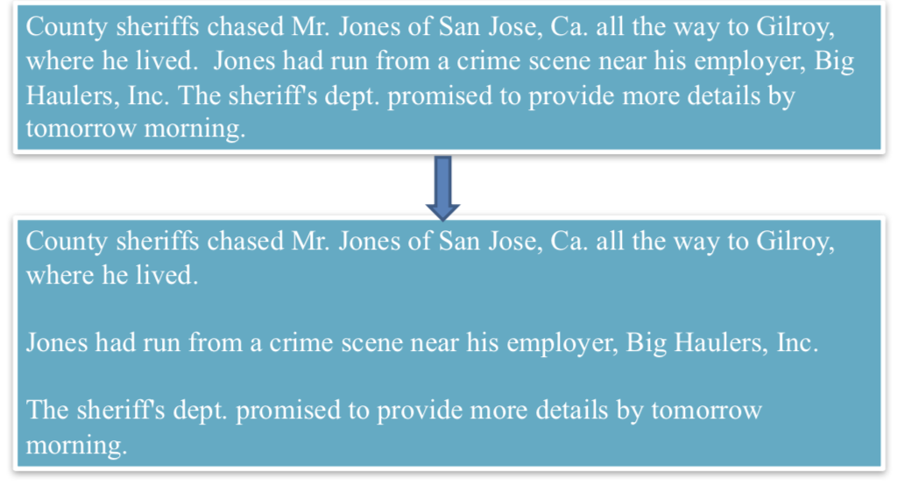
Sentence Segmentation
Notes:
https://www.aclweb.org/anthology/N09-2061/

Slide 6
Word tokenization
Token: word – sequence of characters
Tokenization: convert a string of characters into a sequence of tokens
Separator: tabs, spaces, line breaks
Punctuations, hyphens and apostrophes
Example:
I can't believe that the Carolina Hurricanes won the 2005-2006 Stanley Cup.

Slide 7
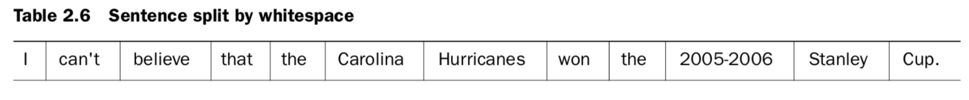
Lucene StandardTokenizer takes into account acronyms and punctuation (also removed period – search use case)
Punctuation is maintained and the contraction can’t has been split up.
OpenNLP is using tokenization as a precursor to performing grammatical processing.
For this type of application, punctuation is useful for helping identify clause boundaries
and can and not have distinct grammatical roles.
Named entity use case (splitting up by token class: alphabetic, numeric, whitespace, et al)
Splitting the date up allows application to identify each component as a date

Slide 8
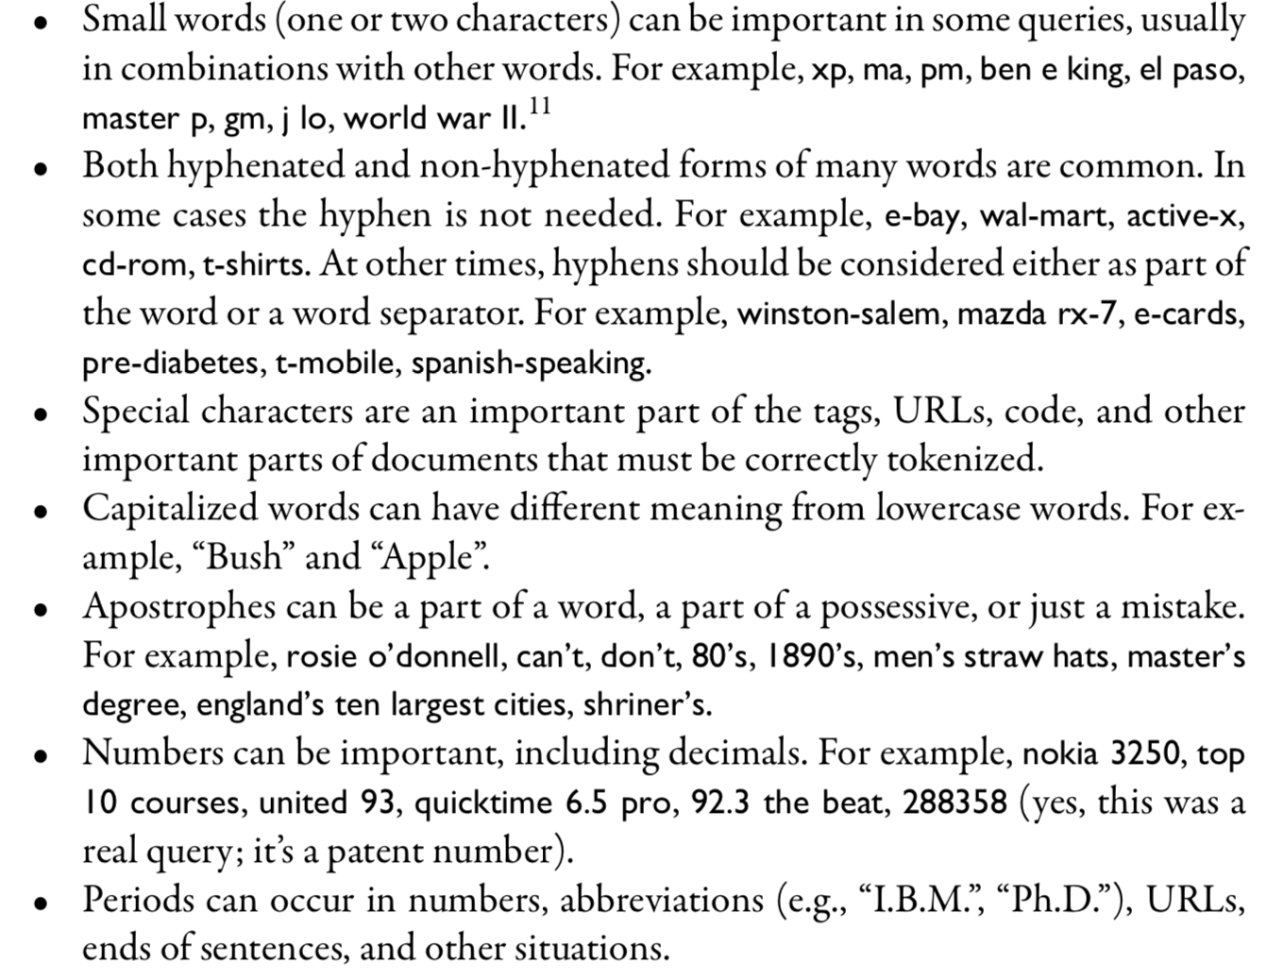
Notes:
IR book

Slide 9
Stop words
Extremely common “function” words that are of little value in helping select documents matching a user need - how are they discovered?
They are application specific – may add some content words to the list e.g., Mr., Mrs., Dr., etc
Should you always filter stop words?
“President of the United States” vs ”President United States”, “The Who”
Originally done to save space in the index, but some newer search engines no longer remove stop words since they can help in more advanced queries (e.g., Google BERT)

Slide 10
“Can you get medicine for someone pharmacy” would have resulted in general information about filling prescriptions at pharmacies.
With BERT, Google pays particular attention to the preposition “for”. Google now understands that you’re asking if a person can pick up someone else’s prescription from a pharmacy.
“2019 Brazil traveler to USA need a visa” would have resulted in information for USA citizens traveling to Brazil. Google would have ignored the word “to”.
With BERT, Google understands that the searcher wants information about visa requirements for Brazilians traveling to the USA.

Slide 11
Stemming and Lemmatization
Inflections: syntactic differences between words
Toy vs Toys , Universe vs University
Stemming: reducing a word to its root form
Lemmatization: uses lexical knowledge bases such as WordNet to obtain word base forms
Porter stemmer examples:
apple, apples --> appl
meanness, meaning --> mean

Slide 12
Stemming and Lemmatization
Algorithmic stemmer: uses a program to decide whether two words are related (based on word suffixes)
Dictionary-based stemmer: relies on pre-created dictionaries of related terms to store term relationships
Algorithmic stemmer examples:
e.g.1, suffix-s stemmer: any word ending with ”s” is plural.
cakes → cake, dogs→ dog; I → is (?)
can’t detect century and centuries.
Can be extended to handle suffixes such as -ing, -ed..
e.g. 2, Porter Stemmer; contains several steps
Step 1a:
- Replace sses by ss (e.g., stresses → stress).
- Delete s if the preceding word part contains a vowel not immediately be-
fore the s (e.g., gaps → gap but gas → gas).
- Replace ied or ies by i if preceded by more than one letter, otherwise by ie
(e.g., ties → tie, cries → cri).
- If suffix is us or ss do nothing (e.g., stress → stress).

Slide 13
Stemming and Lemmatization
Algorithmic stemmer: uses a program to decide whether two words are related (based on word suffixes)
Dictionary-based stemmer: relies on pre-created dictionaries of related terms to store term relationships
Algorithmic stemmer examples:
e.g.1, suffix-s stemmer: any word ending with ”s” is plural.
cakes → cake, dogs→ dog; I → is (?)
can’t detect century and centuries.
Can be extended to handle suffixes such as -ing, -ed..
e.g. 2, Porter Stemmer; contains several steps
Step 1a:
- Replace sses by ss (e.g., stresses → stress).
- Delete s if the preceding word part contains a vowel not immediately be-
fore the s (e.g., gaps → gap but gas → gas).
- Replace ied or ies by i if preceded by more than one letter, otherwise by ie
(e.g., ties → tie, cries → cri).
- If suffix is us or ss do nothing (e.g., stress → stress).

Slide 14
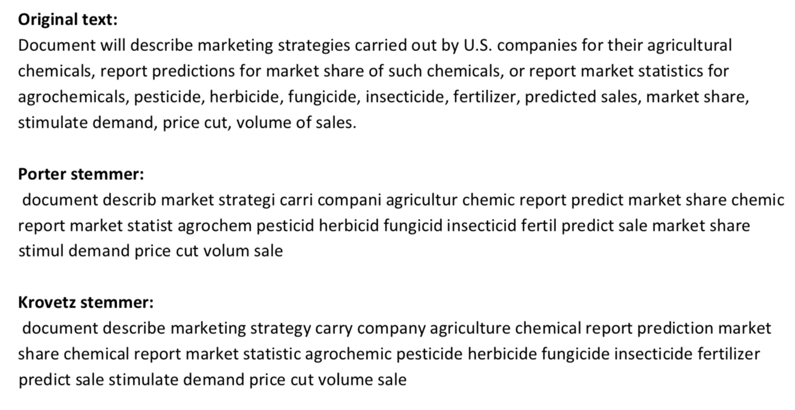
Stemming and Lemmatization
Notes:
Krovetz is a dictionary based stemmer

Slide 15
Categorizing and Tagging words
Universal Part-of-Speech Tagset
Tag | Meaning | English Examples
ADJ | adjective | new, good, high, special, big, local
ADP | adposition | on, of, at, with, by, into, under
ADV | adverb | really, already, still, early, now
CONJ | conjunction | and, or, but, if, while, although
DET | determiner, article | the, a, some, most, every, no, which
NOUN | noun | year, home, costs, time, Africa
NUM | numeral | twenty-four, fourth, 1991, 14:24
PRT | particle | at, on, out, over per, that, up, with
PRON | pronoun | he, their, her, its, my, I, us
VERB | verb | is, say, told, given, playing, would
. | punctuation marks | . , ; !
X | other | ersatz, esprit, dunno, gr8, univeristy
Notes:
Krovetz is a dictionary based stemmer

Slide 16
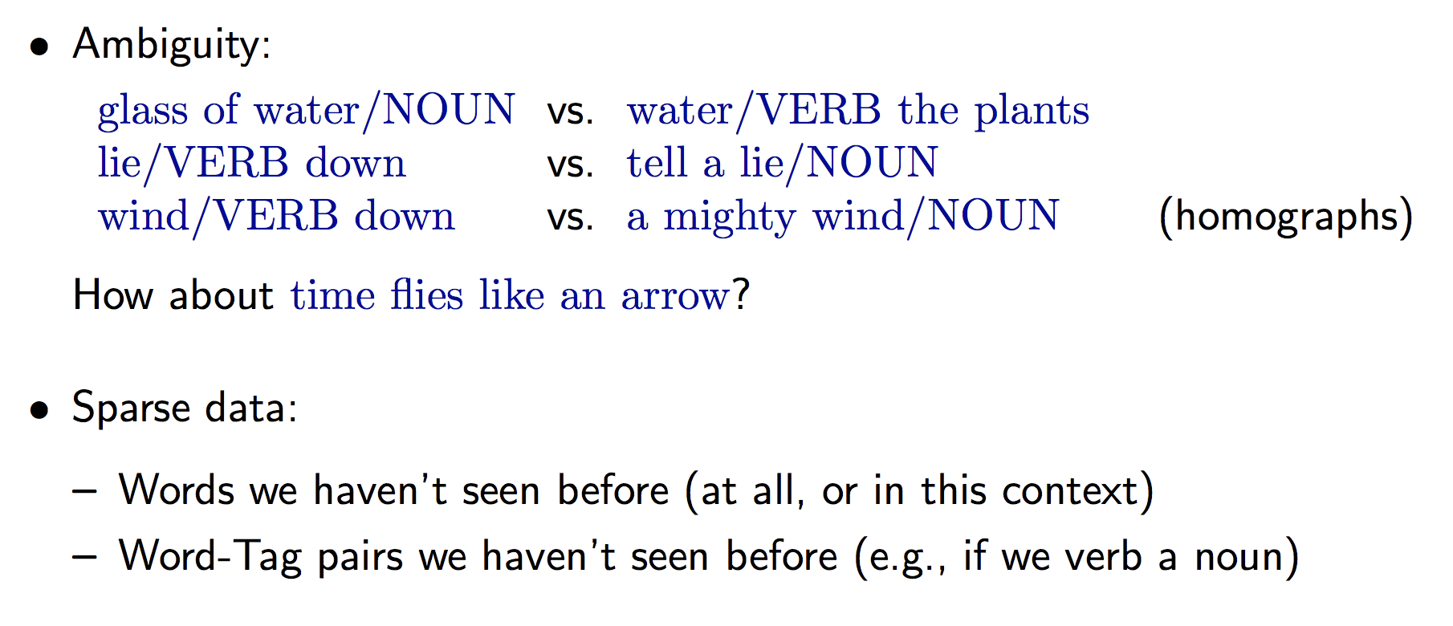
Why is POS tagging hard?
Notes:
Krovetz is a dictionary based stemmer

Slide 17
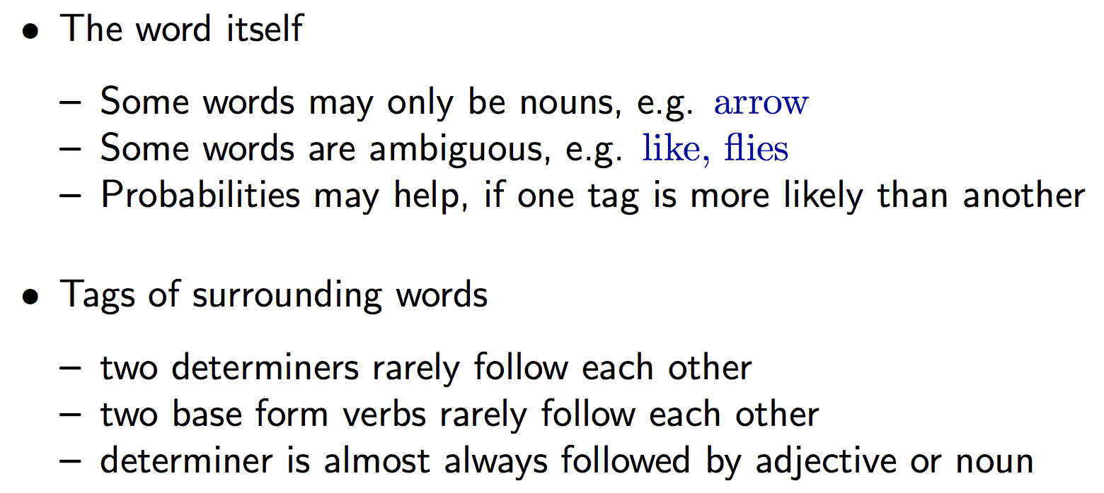
Relevant knowledges for POS tagging models
Notes:
Krovetz is a dictionary based stemmer

Slide 18
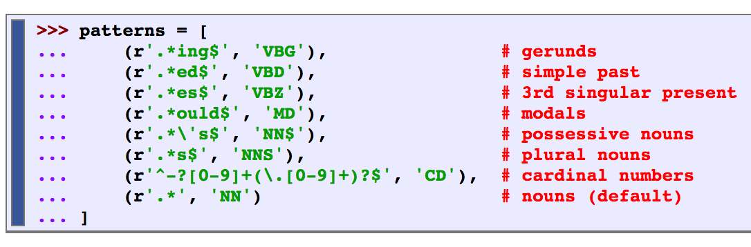
Automatic Tagging
The tag of a word depends on the word and its context within a sentence.
The Default Tagger: assigns the same tag to each token; good for establishing a baseline
The Regular expression tagger: assigns tokens based on matching patterns
E.g., any word ending in ed is the past principle of a verb, and any word ending with ‘s is a possessive noun

Slide 19
Automatic Tagging
The tag of a word depends on the word and its context within a sentence.
The Lookup Tagger: Find the x most frequent words and store their most likely tag.
Backoff strategy: words that are not in the lookup list will be assigned ”None”.
For these cases, assign them the default tag.

Slide 20
Automatic Tagging : N-Gram tagging
Unigram tagging: uses a statistical algorithm (using training data) to assign the most likely tag for a token
Uses only one item of context. E.g., would tag the word wind with the same tag for both the wind or to wind.
N-gram tagger: generalization of the tagger whose context is the current word together with the POS tags of
the n-1 preceding tokens. E.g., n= 3

Slide 21
What did you learn today?
Questions?

